Slide 1

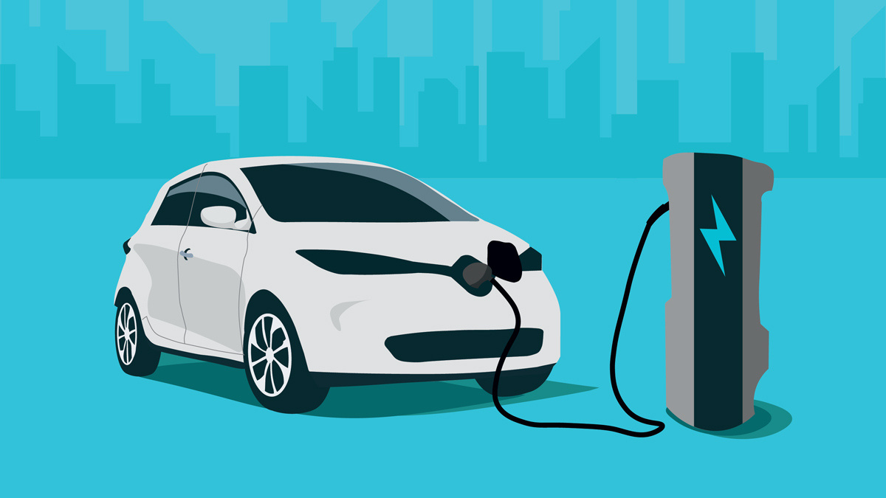


DRIVING THE FUTURE
Strategic Insights for AtliQ Motors’
Electric Vehicle Launch in India
Notes:
Hello everyone, Myself SA, and I'm here to submit my entry for the Resume Project Challenge 12 organized by Code Basics. Through this project, I'll be sharing my insights with AtliQ Motors for their Electric Vehicles (EV) launch in India.

Slide 2

TABLE OF CONTENT
1
INTRODUCTION
2
OBJECTIVES
3
TOOLS USED
4
ANALYSIS AREAS
5
PRIMARY ANALYSIS
6
SECONDARY ANALYSIS
7
THANK-YOU NOTE
Notes:
Here are the key sections of the presentation, with main focus on "Primary Analysis" and "Secondary Analysis"

Slide 3
OBJECTIVES
01
Analysis of Sales and Penetration Trends
02
Evaluate Growth Metrics on the basis of CAGR
03
Examining the factors driving customer choices for 4-wheeler EVs
04
Analyzing the impact of government subsidies on EV adoption rates
05
Strategic Recommendations for Expansion
Notes:
following are The main objectives of this Challenge

Slide 4


TOOLS USED
For Analysis
&
Visualization
For Editing
&
Presentation
Notes:
These are the tools that are being used for the whole project

Slide 5

ANALYSIS AREA
PRIMARY
AREA
SECONDARY
AREA
Market Performance
Analysis
Customer Preferences
Sales Trends and
Growth Metrics
Expansion
Plans
Future Projections and Revenue Estimation
Strategic Recommendations
Notes:
Here, you can see the Analysis Structure:
- Primary Analysis
- Secondary Analysis....... with their respective Sub-categories.

Slide 6
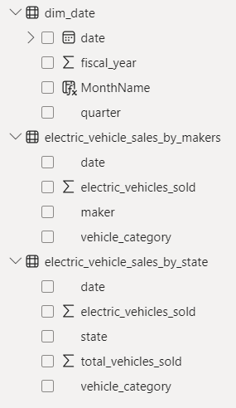
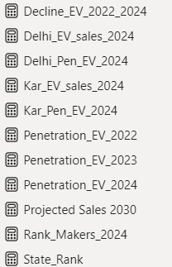
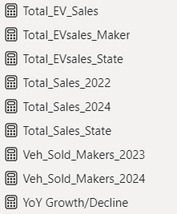
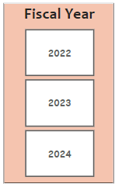
Data Tables
Created Measures
Time
Span
Notes:
Following are the data tables and key measures used for analysis and the dataset Covers fiscal years 2022 to 2024.

Slide 7
PRIMARY
ANALYSIS
Notes:
Let's begin with Primary Analysis

Slide 8

ANALYSIS AREA
PRIMARY
AREA
SECONDARY
AREA
Market Performance
Analysis
Notes:
And the first sub-category is the Market Performance Analysis.

Slide 9
Analysis
1
List the top 3 and bottom 3 makers for the fiscal years 2023 and 2024
in terms of the number of 2-wheelers sold.
Notes:
The first task is to List the top 3 and bottom 3 makers in 2-wheeler sales for FY 2023 and 2024.

Slide 10
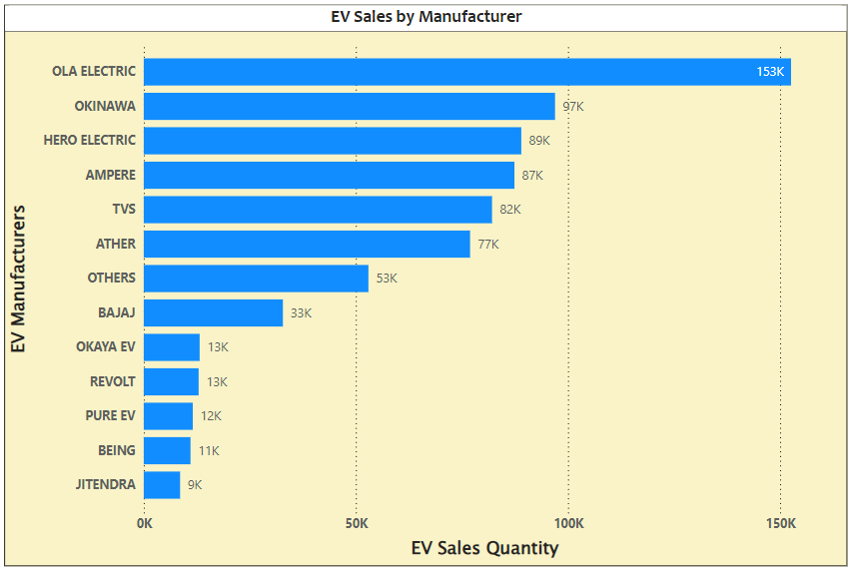
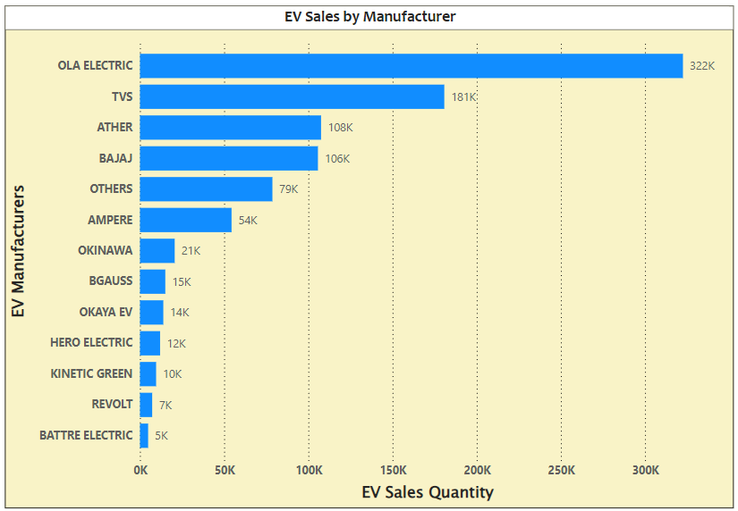

Analysis
1
List the top 3 and bottom 3 makers for the fiscal years 2023 and 2024
in terms of the number of 2-wheelers sold.
Fiscal Year - 2023
Fiscal Year - 2024
INSIGHTS :
OLA was selling 20% of the total sales in 2023 and rose to 34% in the year 2024.
The 3 lowest-selling manufacturers in FY 2023 exited the market by FY 2024, and three new manufacturers entered the market during the same year.
Notes:
11 - You can see the top 3 and bottom 3 makers.

Slide 11
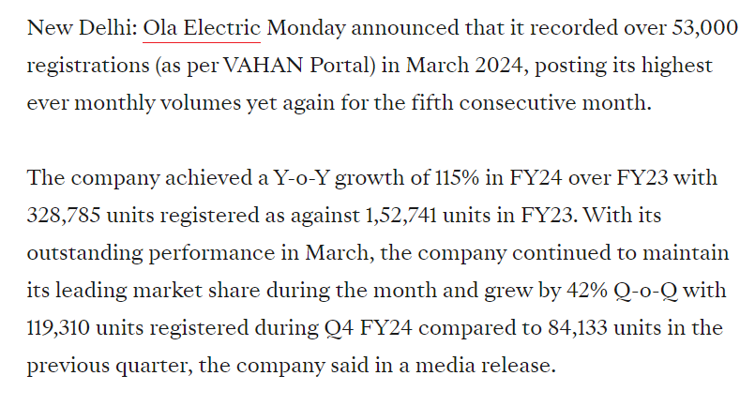
Analysis
1
List the top 3 and bottom 3 makers for the fiscal years 2023 and 2024
in terms of the number of 2-wheelers sold.
Source : auto.economictimes.indiatimes.com
Notes:
18 - An article from auto.economictimes highlights the significant YoY growth of OLA Electric in FY24 over FY23.

Slide 12
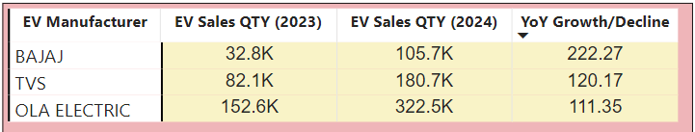
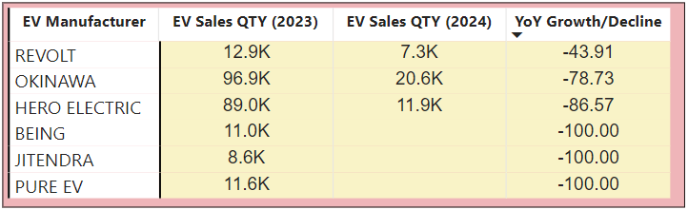
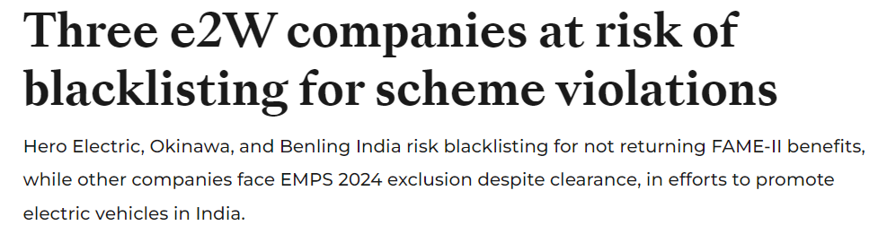
Analysis
1
List the top 3 and bottom 3 makers for the fiscal years 2023 and 2024
in terms of the number of 2-wheelers sold.
Source : auto.economictimes.indiatimes.com
Notes:
An article from auto.economictimes suggests that this may be due to the risk of these companies being blacklisted for scheme violations.

Slide 13
Analysis
2
Identify the top 5 states with the highest penetration rate in
2-wheeler and 4-wheeler EV sales in FY 2024.
Notes:
22 - The second task is to identify the top 5 states with the highest penetration rate in 2-wheeler and 4-wheeler EV sales in FY 2024.

Slide 14
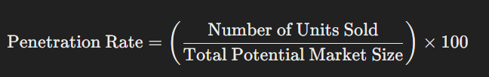
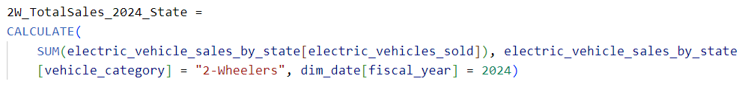
Analysis
2
Identify the top 5 states with the highest penetration rate in
2-wheeler and 4-wheeler EV sales in FY 2024.
What is the Penetration Rate ??
The penetration rate refers to the percentage of a specific product or service sold within a defined market.
It helps businesses understand how much of the potential market they have captured with their product.
Notes:
25 - This is the formula to calculate the PR and the respective measure

Slide 15
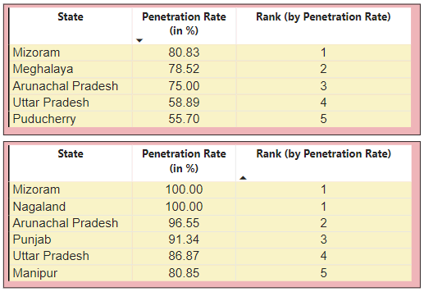
Analysis
2
Identify the top 5 states with the highest penetration rate in
2-wheeler and 4-wheeler EV sales in FY 2024.
2 - Wheelers
INSIGHTS :
Penetration rates in both cases,
3 out of 5 cities are common
Mizoram and Nagaland have shown a perfect penetration rate of 100%.
The Penetration rate of electric
4-wheelers have been significantly
higher than that of 2-wheelers.
4 - Wheelers
Notes:
32 - And we get the following insights :
- For the PR of both 2W and 4W category, 3 out of 5 cities are common.
- Mizoram and Nagaland have achieved a perfect 100% penetration rate.
- The penetration rate for electric 4-wheelers is much higher than for 2-wheelers.
There is a slang in Hindi that goes like :
"Kabhi kabhi jo dikhta hai woh hota nahi hai" which means that appearances can be deceiving and sometimes things aren't always as they seem.

Slide 16
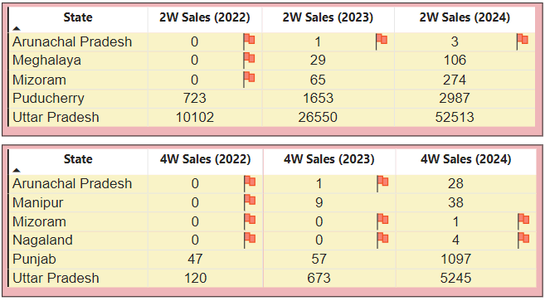
Analysis
2
Identify the top 5 states with the highest penetration rate in
2-wheeler and 4-wheeler EV sales in FY 2024.
2 - Wheelers
4 - Wheelers
Notes:
33 - S0 if we drill down the following result, we get the sales of these states in all the 3 FYs which shows there is a period where these states didn't even got the sales more than 5
And it shows that Mizoram and Nagaland were able to achieve a 100% PR only because the 4W were sold only in the FY 2024.

Slide 17
Analysis
3
List the states with negative penetration (decline) in EV sales from
2022 to 2024?
Notes:
34 - The third task is to List the states with negative penetration or the decline in EV sales from 2022 to 2024?

Slide 18
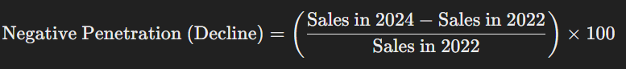
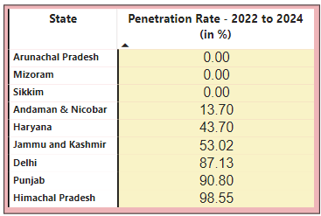

Analysis
3
List the states with negative penetration (decline) in EV sales
from 2022 to 2024?
Notes:
36 - And this is the resultant table.
However, there were no states that experience a decline in EV sales but there are states that shows that there were no sales in those years for the region being analyzed.

Slide 19
Analysis
4
How do the EV sales and penetration rates in Delhi compare to
Karnataka for 2024?
Notes:
37 - The fourth task is to compare the sales and penetration rates for the EVs between Delhi and Karnataka for FY2024

Slide 20
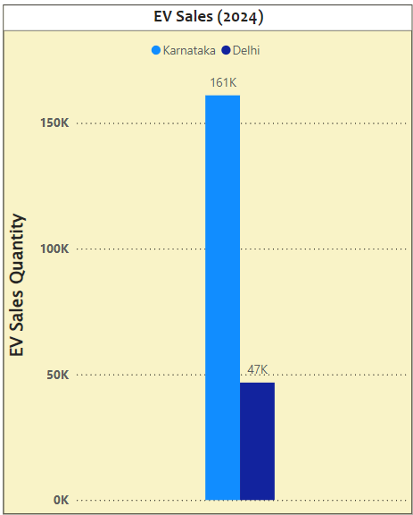
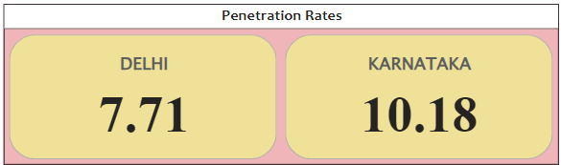
Analysis
4
How do the EV sales and penetration rates in Delhi compare
to Karnataka for 2024?
EV Sales
Comparison
Penetration-Rate Comparison
INSIGHTS :
The significant difference in EV sales between Karnataka (161K) and Delhi (47K) in 2024 indicates a strong preference and adoption of electric vehicles in Karnataka.
The data highlight Karnataka as a pivotal market for EV growth and suggest opportunities for similar strategies in Delhi.
Notes:
39 - Following are the insights that can be drawn from the visuals :
- Karnataka's EV sales were significantly higher at 161K compared to Delhi's 47K.
- This indicates a strong preference for EVs in Karnataka, making it a crucial market for growth.
- Similar strategies could potentially boost EV sales in Delhi as well.

Slide 21
ANALYSIS AREA
PRIMARY
AREA
SECONDARY
AREA
Market Performance
Analysis
Sales Trends and
Growth Metrics
Notes:
40 - Moving further to the second sub-category of Primary area -- Sales Trends and Growth Metrics

Slide 22
Analysis
5
What are the quarterly trends based on sales volume for the
top 5 EV makers (4-wheelers) from 2022 to 2024 ?
Notes:
41 - The first task here is to examine how sales numbers for the top 5 electric car makers changed every quarter from 2022 to 2024.

Slide 23
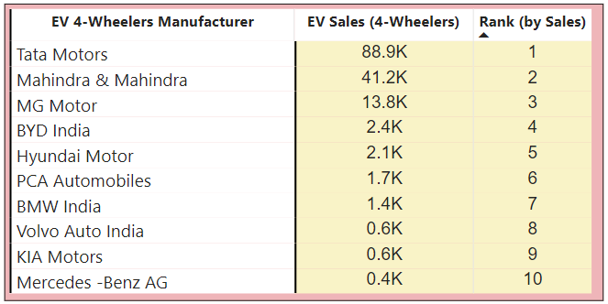
Analysis
5
What are the quarterly trends based on sales volume for the
top 5 EV makers (4-wheelers) from 2022 to 2024 ?
Notes:
43 - Here is the top 5 manufacturers in the 4-w category

Slide 24
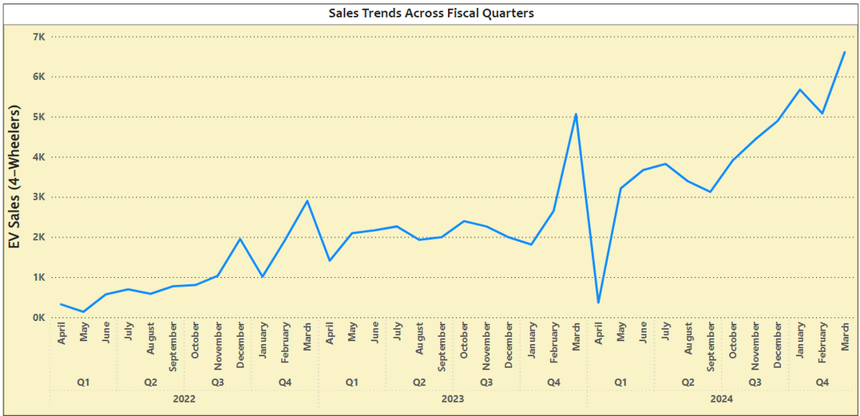
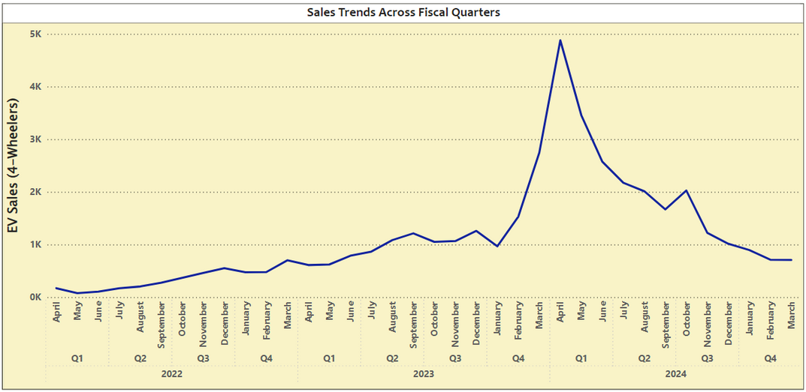
Analysis
5
What are the quarterly trends based on sales volume for the
top 5 EV makers (4-wheelers) from 2022 to 2024 ?
Tata Motors
Mahindra and Mahindra
Notes:
44 - Following is the sales trend across fiscal quarters for Tata Motors and Mahindra & Mahindra

Slide 25
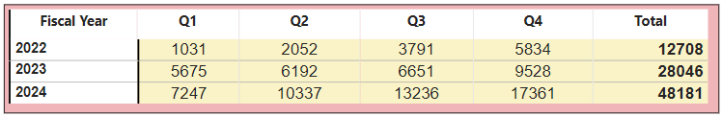
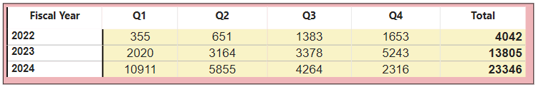
Analysis
5
What are the quarterly trends based on sales volume for the
top 5 EV makers (4-wheelers) from 2022 to 2024 ?
Tata Motors
Mahindra and Mahindra
INSIGHTS :
Tata Motors' vehicle sales jumped from 13K in 2022 to 28K in 2023, marking a 120.63% increase.
Sales kept rising in 2024, reaching 48K vehicles, up 71.87% from 2023.
This steady growth shows Tata Motors is increasing both their sales and their share of the EV market each year.
INSIGHTS :
The company saw a huge increase in sales in 2023, up by over 240% from 2022.
This suggests that their market strategy worked well, likely due to better brand recognition, improved vehicles, or good market conditions.
Understanding what drove this growth can help achieve similar success in the future.
Notes:
46 - And when we drill down the sales trend, we get the following insights :
- Tata Motors' vehicle sales jumped from 13K in 2022 to 28K in 2023, marking a 120.63% increase.
- Sales kept rising in 2024, reaching 48K vehicles, up 71.87% from 2023.
- This steady growth shows Tata Motors is increasing both their sales and their share of the EV market each year.
- The company saw a huge increase in sales in 2023, up by over 240% from 2022.
- This suggests that their market strategy worked well, likely due to better brand recognition, improved vehicles, or good market conditions.
- Understanding what drove this growth can help achieve similar success in the future.

Slide 26
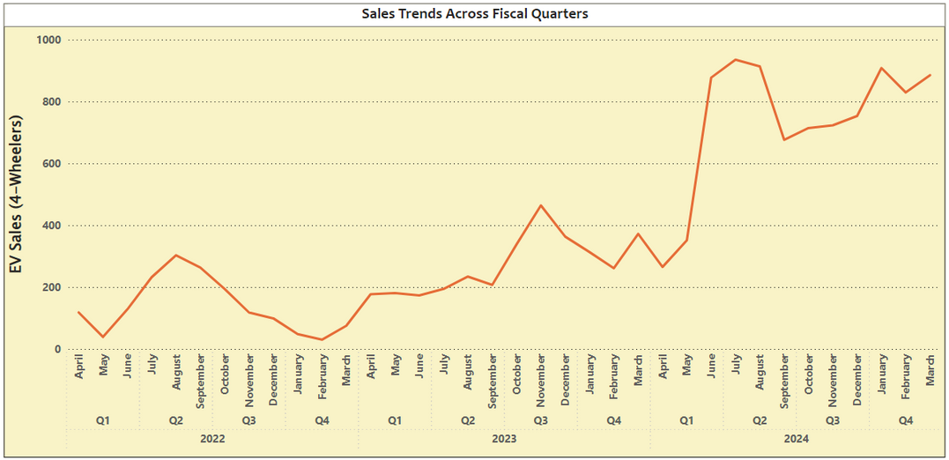
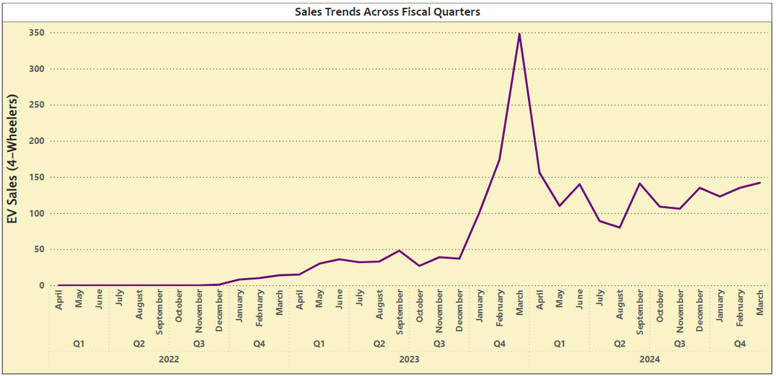
Analysis
5
What are the quarterly trends based on sales volume for the
top 5 EV makers (4-wheelers) from 2022 to 2024 ?
MG Motor
BYD India
Notes:
47 - Following is the sales trend across fiscal quarters for MG Motor and BYD India

Slide 27
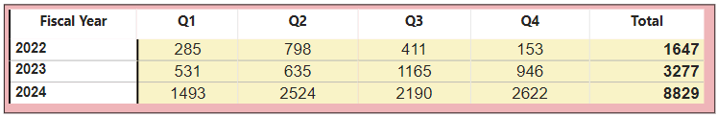
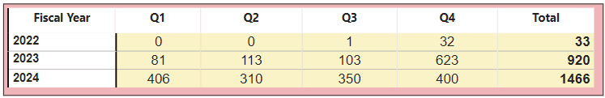
Analysis
5
What are the quarterly trends based on sales volume for the
top 5 EV makers (4-wheelers) from 2022 to 2024 ?
MG Motor
BYD India
INSIGHTS :
The company’s sales grew by 98.9% from 2022 to 2023 and then surged by 169.5% from 2023 to 2024.
This huge increase shows that the company’s products are popular, likely because of new features, good prices, or strong marketing
INSIGHTS :
The jump from 33 to 920 vehicles is remarkable, likely due to increased production, better market presence, or a successful new model.
Though growth has slowed slightly, it remains strong at nearly 60%, showing ongoing demand and effective market entry.
Notes:
49 - And when we drill down the sales trend, we get the following insights :
- The company’s sales grew by 98.9% from 2022 to 2023 and then surged by 169.5% from 2023 to 2024.
- This huge increase shows that the company’s products are popular, likely because of new features, good prices, or strong marketing
- The jump from 33 to 920 vehicles is remarkable, likely due to increased production, better market presence, or a successful new model.
- Though growth has slowed slightly, it remains strong at nearly 60%, showing ongoing demand and effective market entry.

Slide 28
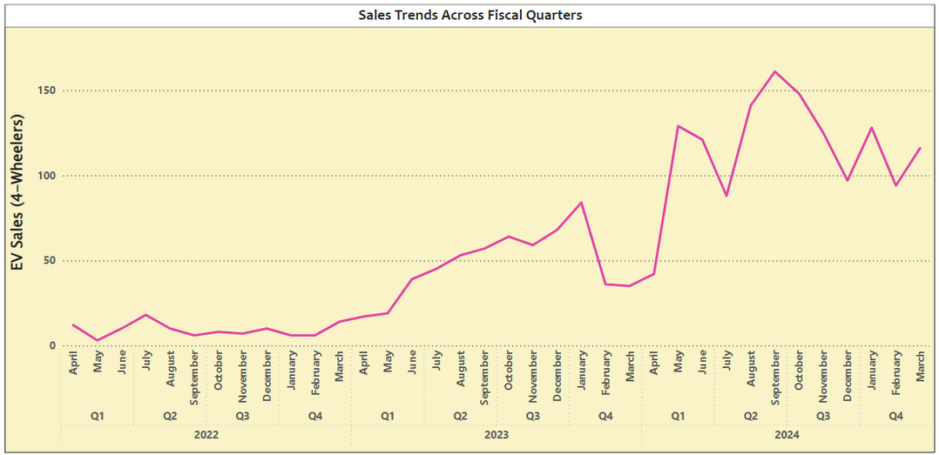
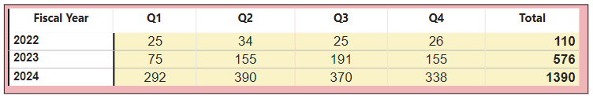
Analysis
5
What are the quarterly trends based on sales volume for the
top 5 EV makers (4-wheelers) from 2022 to 2024 ?
Hyundai Motor
INSIGHTS :
Sales surged by an impressive 423.64%, reflecting strong brand recognition and market acceptance.
Although the growth rate slowed to 141.32%, the significant increase in vehicles sold shows the company is still growing steadily.
Hyundai Motor's consistent yearly growth in sales underscores its leadership in the electric vehicle market, demonstrating its ability to scale quickly and gain market share.
Notes:
52 - Drilling down further, we get the following insights
- Sales surged by an impressive 423.64%, reflecting strong brand recognition and market acceptance.
- Although the growth rate slowed to 141.32%, the significant increase in vehicles sold shows the company is still growing steadily.
- Hyundai Motor's consistent yearly growth in sales underscores its leadership in the electric vehicle market, demonstrating its ability to scale quickly and gain market share.

Slide 29
Analysis
6
List down the compounded annual growth rate (CAGR) in 4-wheeler
units for the top 5 makers from 2022 to 2024.
Notes:
54 - The next task is to Calculate the compounded annual growth rate (CAGR) in 4-wheeler units for the top 5 makers from 2022 to 2024.

Slide 30
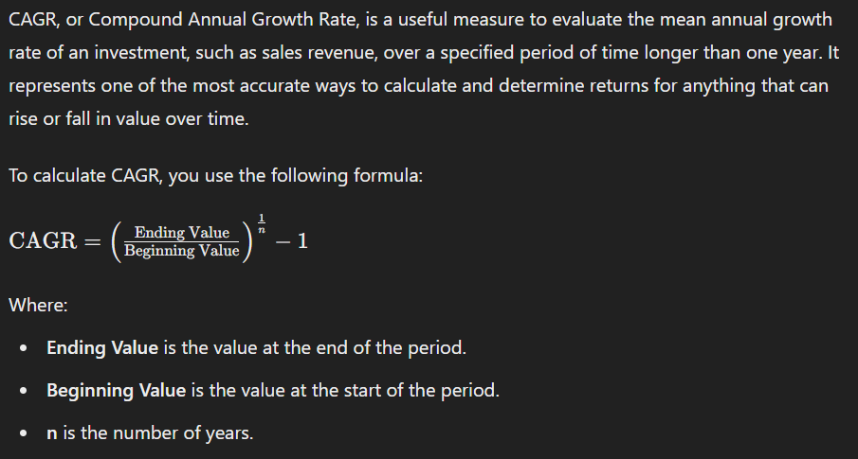
Analysis
6
List down the compounded annual growth rate (CAGR) in 4-wheeler
units for the top 5 makers from 2022 to 2024.
What is CAGR ?
CAGR, or Compound Annual Growth Rate, is a useful measure to evaluate the mean annual growth rate of an investment, such as sales revenue, over a specified period of time longer than one year.
It represents one of the most accurate ways to calculate and determine returns for anything that can rise or fall in value over time.
Notes:
57 - This is the formula to calculate the CAGR

Slide 31
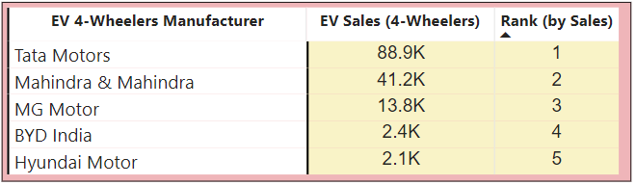
Analysis
6
List down the compounded annual growth rate (CAGR) in 4-wheeler
units for the top 5 makers from 2022 to 2024.
Notes:
61 - Here is the top 5 manufacturers in the 4-w category

Slide 32
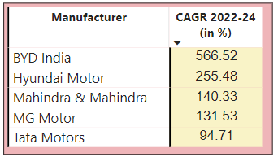
Analysis
6
List down the compounded annual growth rate (CAGR) in 4-wheeler
units for the top 5 makers from 2022 to 2024.
Notes:
63 - Applying the CAGR formula, we get the following :

Slide 33
Analysis
6
List down the compounded annual growth rate (CAGR) in 4-wheeler
units for the top 5 makers from 2022 to 2024.
INSIGHTS :
Explosive Growth in BYD India:
BYD India's sales skyrocketed with a growth rate of 567%, going from 33 units in 2022 to 1,466 units in 2024.
This surge could be due to successful new products, strong marketing, or changing consumer preferences.
Strong Performance of Hyundai Motor:
With a CAGR of 255%, Hyundai Motor shows significant growth, though not as steep as BYD India.
Their consistent growth indicates a solid market strategy and product acceptance.
Moderate Growth in MG Motors and Mahindra & Mahindra:
These two companies have relatively moderate CAGRs of 139% and 132%, respectively.
These figures suggest steady growth, likely driven by a loyal customer base and an expanding product range.
Slowest Growth in Tata Motors:
Tata Motors has the lowest CAGR of 94%, which is still considerable but much lower compared to others.
Given their higher base in 2022, this slower growth may reflect market saturation or more conservative expansion strategies.
Notes:
64 - And the following insights can be drawn :
- BYD India's sales skyrocketed with a growth rate of 567%, going from 33 units in 2022 to 1,466 units in 2024.
- This surge could be due to successful new products, strong marketing, or a change in consumer preferences.
- Hyundai Motor grew by 255%, showing solid, steady progress.
- This suggests their market strategy and products are well-received.
- MG Motors and Mahindra & Mahindra grew by 139% and 132%, respectively.
- Their steady growth is likely supported by a loyal customer base and a wider range of products.
- Tata Motors had the slowest growth at 94%.
- Though still growing, this might be due to market saturation or a more cautious approach, given their already large presence in 2022.

Slide 34
Analysis
7
List down the top 10 states that had the highest CAGR from 2022 to 2024
in total vehicles sold.
Notes:
65 - The next task is to list the top 10 states with the highest CAGR from 2022 to 2024 in total vehicles sold.

Slide 35
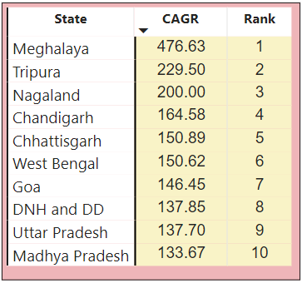
Analysis
7
List down the top 10 states that had the highest CAGR from 2022 to 2024
in total vehicles sold.
(in %)
Notes:
66 - After applying the CAGR formula, we get the following resultant table.

Slide 36
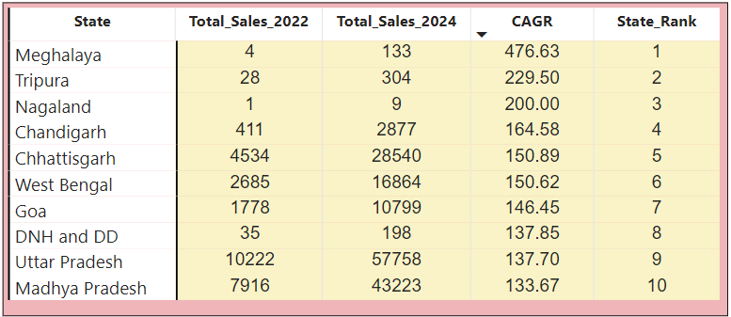
Analysis
7
List down the top 10 states that had the highest CAGR from 2022 to 2024
in total vehicles sold.
Notes:
67 - However, if we drill down further we have a surprising observation...... Nagaland, despite having very low total sales, ranks 3rd in CAGR among 34 states.

Slide 37
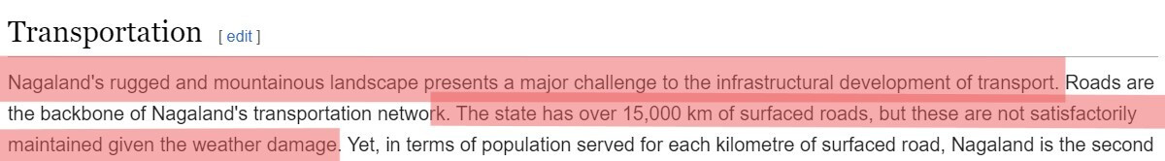
Analysis
7
List down the top 10 states that had the highest CAGR from 2022 to 2024
in total vehicles sold.
Bad Maintenance of Roads
Notes:
68, 69 - This surprising result leads us to investigate why Nagaland has low sales, which may be due to "poor road maintenance," as highlighted by various articles.

Slide 38
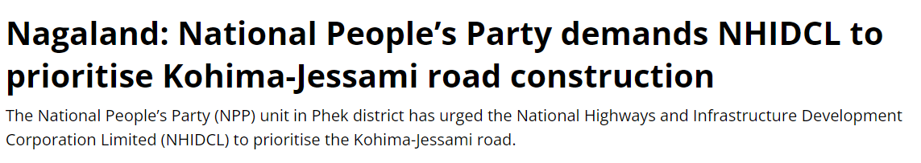
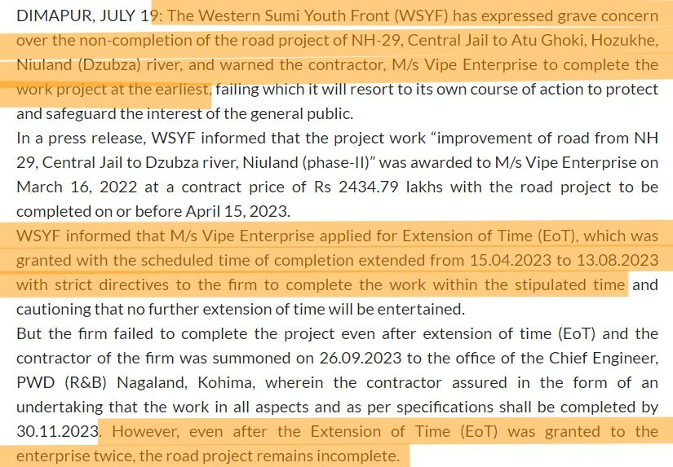
Analysis
7
List down the top 10 states that had the highest CAGR from 2022 to 2024
in total vehicles sold.
Source : indiatodayne.in
Source : nagalandpage.com

Slide 39
Analysis
8
What are the peak and low season months for EV sales based on the
data from 2022 to 2024?
Notes:
70 - Moving further, the next task is to identify the peak and low season months for EV sales from 2022 to 2024.

Slide 40
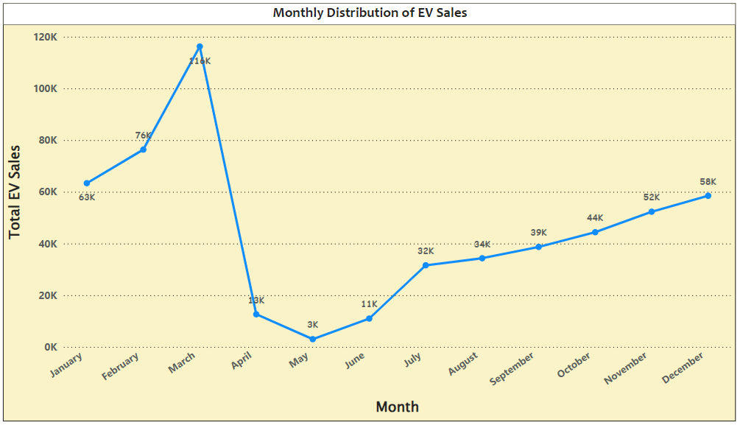
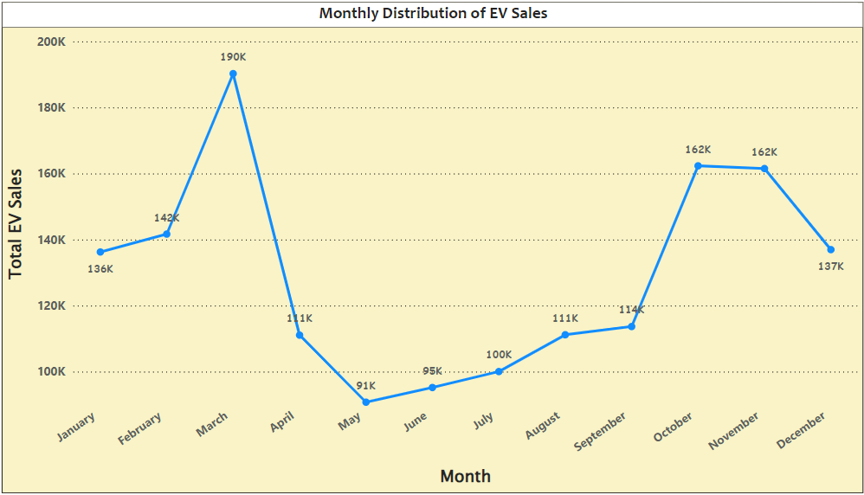
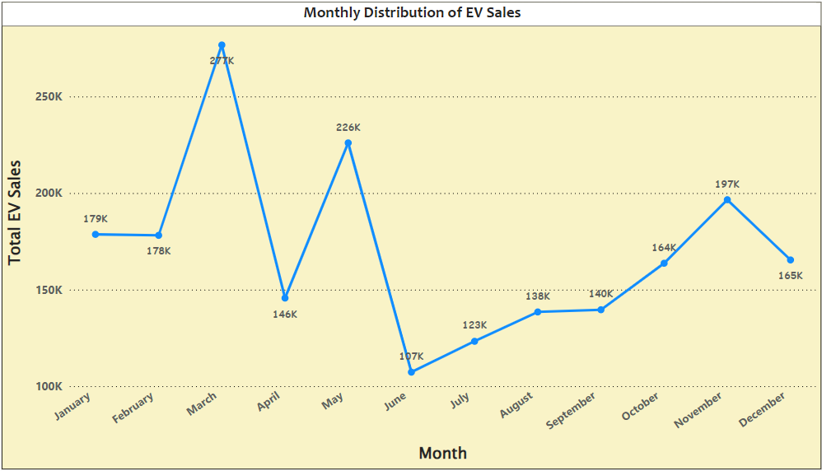
Fiscal Year - 2022
Fiscal Year - 2023
Fiscal Year - 2024
INSIGHTS :
Sales peak consistently in the final month of the last fiscal quarter.
There is a steady increase in sales during the third quarter of each fiscal year.
Notes:
72 - The line chart reveals two common sales patterns each year:
- Sales peak consistently in the final month of the last fiscal quarter (i.e in Jan, Feb, Mar)
- There is a steady increase in sales during the second and third quarter of each fiscal year.

Slide 41
Analysis
8
What are the peak and low season months for EV sales based
on the data from 2022 to 2024?
Fiscal Year-End Push:
As the financial year in India ends in March, many people and businesses buy vehicles before the new fiscal year starts.
This is often done for financial planning and tax-saving purposes, as it can help them claim depreciation benefits or tax deductions.
Increased Availability of Models:
Automakers often release new models or variants at the start of the calendar year, so by the last quarter of the fiscal year, consumers have more options and the latest models to choose from.
Festival Purchases:
India's festival season, starting in September is a significant time for consumers, often associated with purchasing valuable items like cars, jewelry, and electronics.
Automakers and retailers often offer special discounts, promotions, and new product launches to
attract buyers, further boosting sales during this festive season.
Notes:
73 - Following could be the Reasons for these patterns:
- Fiscal Year-End Push: Consumers and businesses buy before March for tax benefits.
- Government Incentives: EV subsidies and incentives like the FAME scheme are extended towards the fiscal year-end.
- Promotional Campaigns: Automakers offer discounts in the last quarter to meet annual sales targets.
- New Models: Automakers release new models by the last quarter, boosting sales.
- Infrastructure Growth: Improvements in EV charging infrastructure by the fiscal year-end make EV ownership more attractive.

Slide 42
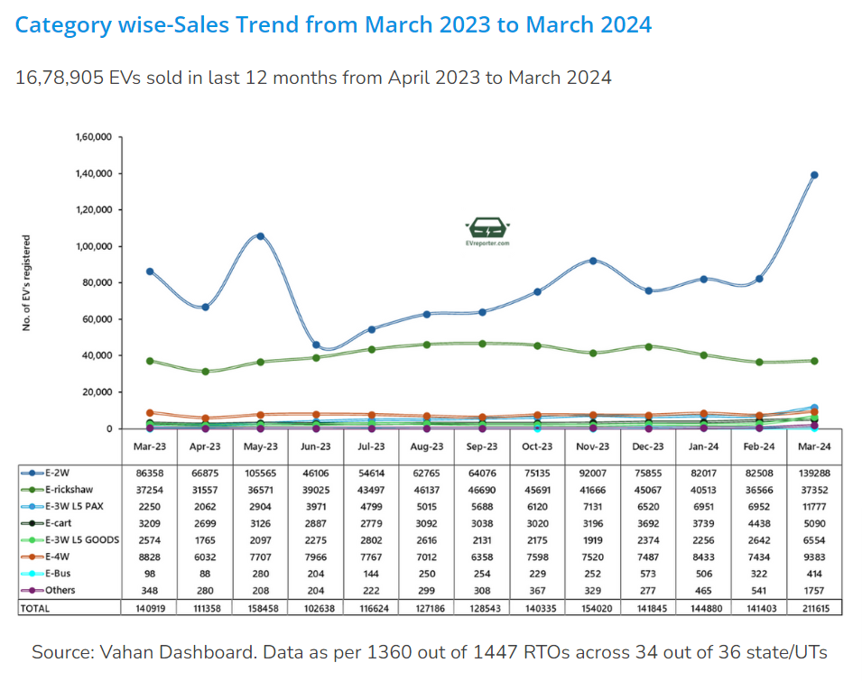
Analysis
8
What are the peak and low season months for EV sales based
on the data from 2022 to 2024?
Source : vahan.parivahan.gov.in
Notes:
74, 75 - And the following articles also shows the sales trend of FY 2024

Slide 43
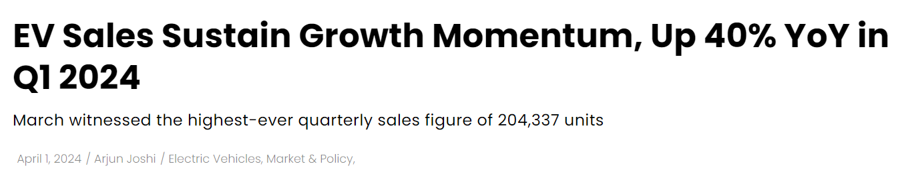
Analysis
8
What are the peak and low season months for EV sales based
on the data from 2022 to 2024?
Source : mercomindia.com

Slide 44
ANALYSIS AREA
PRIMARY
AREA
SECONDARY
AREA
Market Performance
Analysis
Sales Trends and
Growth Metrics
Future Projections and Revenue Estimation
Notes:
Moving to the third sub-category: Future Projection and Revenue Estimation

Slide 45
Analysis
9
What is the projected number of EV sales (including 2-wheelers
and 4-wheelers) for the top 10 states by penetration rate, in 2030, based
on the compounded annual growth rate (CAGR) from previous years?
Notes:
The first task under this sub-category is to Predict the estimated number of EV sales (including 2-wheelers and 4-wheelers) in 2030 for the top 10 states with the highest penetration rates, based on previous years' growth rates.

Slide 46
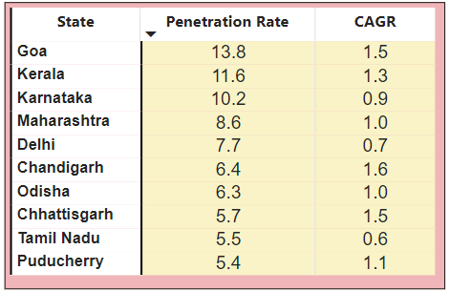
Analysis
9
What is the projected number of EV sales (including 2-wheelers
and 4-wheelers) for the top 10 states by penetration rate, in 2030, based
on the compounded annual growth rate (CAGR) from previous years?
Notes:
79 - The current table shows the top 10 states in terms of PR and with their CAGR respectively.

Slide 47
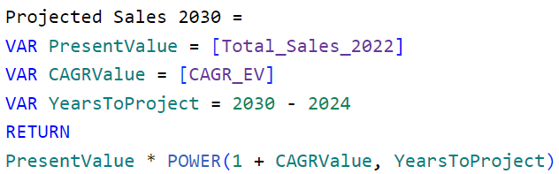
Analysis
9
What is the projected number of EV sales (including 2-wheelers
and 4-wheelers) for the top 10 states by penetration rate, in 2030, based
on the compounded annual growth rate (CAGR) from previous years?
Notes:
The following formula will be used to calculate the Projected sales

Slide 48
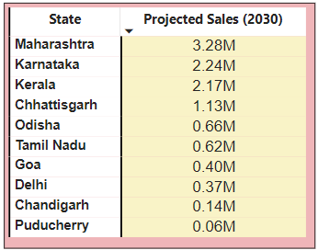
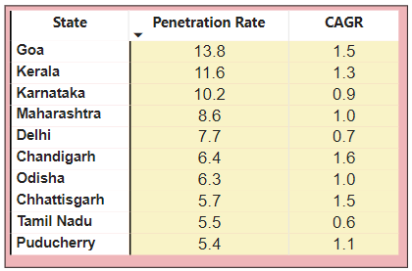
Analysis
9
What is the projected number of EV sales (including 2-wheelers
and 4-wheelers) for the top 10 states by penetration rate, in 2030, based
on the compounded annual growth rate (CAGR) from previous years?
Penetration Rate and CAGR are in %
Notes:
Applying the values in the formula
We get CAGR and Projected Sales respectively.

Slide 49
Analysis
9
What is the projected number of EV sales (including 2-wheelers
and 4-wheelers) for the top 10 states by penetration rate, in 2030, based
on the compounded annual growth rate (CAGR) from previous years?
INSIGHTS :
Maharashtra, Karnataka, and Kerala are expected to lead the EV market, with each state projected to sell over 2 million units, showing strong growth and adoption.
Chandigarh and Puducherry, however, have slower growth, with sales unlikely to exceed 0.2 million units. This may require better strategies or incentives to increase adoption.
Goa, despite having the highest penetration rate at 13.8%, is projected to sell only 0.5 million units by 2030, likely due to its smaller population.
On the other hand, Chhattisgarh, with a 5.7% penetration rate, is projected to sell 1.15 million units by 2030, indicating rapid growth and a strong market presence.
Notes:
86 - And the following insights can be drawn :
- Maharashtra, Karnataka, and Kerala are expected to lead with over 2 million EV sales each, showing strong growth.
- Chandigarh and Puducherry may need better strategies as their sales are unlikely to exceed 0.2 million units.
- Goa, despite a 13.8% penetration rate, is projected to sell only 0.5 million units due to its smaller population.
- Chhattisgarh, with a 5.7% penetration rate, is projected to sell 1.15 million units, showing rapid growth.

Slide 50
Analysis
10
Estimate the revenue growth rate of 4-wheeler and 2-wheelers EVs in
India for 2022 vs 2024 and 2023 vs 2024, assuming an average unit price.
(2W - 85,000) and (4W - 15,00,000)
Notes:
87 - The next task is to Calculate the revenue growth rate for 4-wheeler and 2-wheeler EVs in India between the given years and assuming the given prices

Slide 51
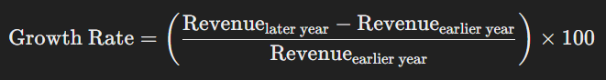
Analysis
10
Estimate the revenue growth rate of 4-wheeler and 2-wheelers EVs in
India for 2022 vs 2024 and 2023 vs 2024, assuming an average
unit price. (2W - 85,000) and (4W - 15,00,000)
STEP 1 :
Calculate Revenue for Each Fiscal Year for 2-Wheelers and 4-Wheelers respectively
STEP 2 :
Calculate the Revenue Growth Rate between the required Fiscal Years.
Notes:
89 - The calculation is divided into two steps:
- Calculating the yearly revenue
- Applying the growth rate (GR) formula

Slide 52
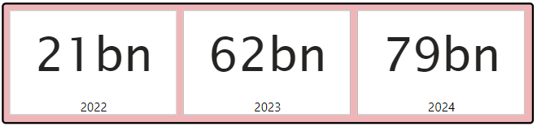
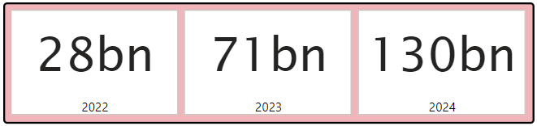
Analysis
10
Estimate the revenue growth rate of 4-wheeler and 2-wheelers EVs in
India for 2022 vs 2024 and 2023 vs 2024, assuming an average
unit price. (2W - 85,000) and (4W - 15,00,000)
STEP 1 :
2-Wheelers Revenue
4-Wheelers Revenue
STEP 2 :
Notes:
Combining the two steps, we get the states with their respective FY growth rates.

Slide 53


Analysis
10
Estimate the revenue growth rate of 4-wheeler and 2-wheelers EVs in
India for 2022 vs 2024 and 2023 vs 2024, assuming an average
unit price. (2W - 85,000) and (4W - 15,00,000)
Growth Rate is in %
2-Wheelers
4-Wheelers
The red circle shows a decline in the Growth Rate from the current FY to the next FY
The exclamation mark informs the unavailability of data
Notes:
94 - The red circle shows a decline in the Growth Rate from the current FY to the next FY and The exclamation mark informs the unavailability of data.
This wraps up the primary analysis for the project. And now, we will move onto the Secondary Analysis.

Slide 54
SECONDARY
ANALYSIS
Notes:
Moving further to the Secondary Analysis

Slide 55
ANALYSIS AREA
PRIMARY
AREA
SECONDARY
AREA
Market Performance
Analysis
Customer Preferences
Sales Trends and
Growth Metrics
Future Projections and Revenue Estimation
Notes:
Starting with the first sub-category of Secondary area -- Customer Preferences

Slide 56
Analysis
1
What are the primary reasons for customers choosing 4-wheeler
EVs in 2023 and 2024
(cost savings, environmental concerns, government incentives)?
Notes:
The first task is to find out the primary reasons for customers choosing 4-wheeler EVs in 2023 and 2024 based on the mentioned factors

Slide 57
Analysis
1
What are the primary reasons for customers choosing 4-wheeler
EVs in 2023 and 2024
(cost savings, environmental concerns, government incentives)?
Cost Savings
Fuel Savings:
4-wheeler EVs have significantly lower fuel costs compared to traditional internal combustion engine (ICE) vehicles.
Electricity is cheaper than petrol or diesel, resulting in substantial savings on fuel expenses.
Maintenance Savings:
EVs have fewer moving parts than ICE vehicles, which translates to lower maintenance and repair costs.
Components such as engines, transmissions, and exhaust systems, which often require costly maintenance, are either absent or less complex in EVs.
Long-term Savings:
Although the initial cost of a 4-wheeler EV is high, the total cost of ownership over the vehicle's lifetime can be lower due to these reduced operating and maintenance costs.
Notes:
98 - Starting with The first factor : Cost Saving. There are several reasons :
- 4W EVs cost less to fuel because electricity is cheaper than petrol or diesel.
- EVs have fewer parts than traditional cars, so they cost less to maintain and repair.
- Even though EVs are more expensive to buy initially, their lower running and maintenance costs can make them cheaper overall in the long run.

Slide 58
Analysis
1
What are the primary reasons for customers choosing 4-wheeler
EVs in 2023 and 2024
(cost savings, environmental concerns, government incentives)?
Pollution Reduction:
EVs don’t have exhaust pipes, so they don’t release harmful gases into the air.
This helps to lower air pollution, which is especially important in India, where many cities have poor air quality.
Climate Change:
Awareness of climate change and the need to reduce carbon footprints are driving consumers to choose more environmentally friendly transportation options.
EVs contribute to reducing greenhouse gas emissions, aligning with global and national environmental goals.
Eco-conscious Consumers:
A growing segment of consumers prioritize sustainability and wish to lead an eco-friendly lifestyle.
Choosing an EV is a tangible way to contribute to environmental conservation.
Environmental Concerns
Notes:
99 - Looking at the second factor : Environmental Concerns.
- EVs don't have exhaust pipes, so they don't release harmful gases, helping to reduce air pollution—important in cities with poor air quality.
- People are more aware of climate change and want to reduce their carbon footprint. EVs cut down on greenhouse gas emissions, supporting environmental goals.
- More people want to live sustainably and choose eco-friendly options. Driving an EV is an easy way to help protect the environment.

Slide 59
Analysis
1
What are the primary reasons for customers choosing 4-wheeler
EVs in 2023 and 2024
(cost savings, environmental concerns, government incentives)?
Government Incentives
Purchase Incentives:
The Indian government offers various financial incentives to reduce the effective cost of EVs, including subsidies, tax rebates, and reduced registration fees.
These incentives make 4-wheeler EVs more affordable for consumers.
Charging Infrastructure:
Investments in expanding the EV charging infrastructure have made it more convenient for consumers to own and operate 4-wheeler EVs.
The availability of charging stations reduces range anxiety and enhances the practicality of EVs for daily use.
Policy Support:
State-level policies, such as road tax exemptions, reduced toll fees, and preferential parking, further encourage the adoption of 4-wheeler EVs.
Notes:
100 - Looking at the third factor : Government Incentives.
- The Indian government offers financial perks like subsidies, tax rebates, and lower registration fees to make 4-wheeler EVs more affordable.
- More EV charging stations are being built, making it easier for people to own and use 4-wheeler EVs by reducing range anxiety.
- State policies like exemptions from road tax, lower toll fees, and special parking options boost the adoption of 4-wheeler EVs.
101 - In conclusion, I can say that Customers choose 4-wheeler EVs for several key reasons, each influencing their decision in unique ways

Slide 60
Analysis
2
How does the availability of charging stations infrastructure correlate
with the EV sales and penetration rates in the top 5 states?
Notes:
The next task is to find out how does the availability of charging stations affect EV sales & market share in the top 5 states?

Slide 61


Analysis
2
How does the availability of charging stations infrastructure correlate
with the EV sales and penetration rates in the top 5 states?
Top 5 states by Penetration Rate
2 - Wheelers
Top 7 states by Total Sales
4 - Wheelers
Notes:
103 - Following tables show the top 5 states in terms of PR and TS and I’ve listed reasons showing how the number of charging stations impacts EV sales and market share in the top 5 states

Slide 62



Analysis
2
How does the availability of charging stations infrastructure correlate
with the EV sales and penetration rates in the top 5 states?
Charging Infrastructure and EV Adoption:
The presence of a robust network of charging stations increases the convenience for EV owners, reducing range anxiety and making it more feasible for consumers to switch to electric vehicles.
Regions with a higher number of charging stations typically see higher EV adoption rates because consumers are more likely to purchase EVs when they know they have reliable access to charging infrastructure.
Notes:
105 - And according to these articles, many states are already in the work of building more charging stations

Slide 63


Analysis
2
How does the availability of charging stations infrastructure correlate
with the EV sales and penetration rates in the top 5 states?
2. Policy and Government Initiatives:
Government policies that incentivize the installation of charging stations also lead to increased EV sales.
India’s FAME schemes have provided financial incentives for establishing charging infrastructure, promoting EV adoption.
Source : punehindtimes.com
Source : deshgujarat.com
Notes:
107 - And according to these articles, government is working on several initiatives to make India petrol/diesel free by 2030

Slide 64


Analysis
2
How does the availability of charging stations infrastructure correlate
with the EV sales and penetration rates in the top 5 states?
3. Market Response and Consumer Behavior:
Early adopters in regions with developed charging infrastructure often influence market trends, leading to increased sales and market penetration.
Collaboration between public and private sectors in establishing charging stations can significantly impact EV adoption rates.
Source :
EY Mobility
Consumer Index
Source : Vahan Dashboard, Bain Analysis
Notes:
109 - And according to the following articles, EY survey shows the preference of customers in EVs and Vahan Dashboard shows India's overall EV penetration target by 2030

Slide 65
ANALYSIS AREA
PRIMARY
AREA
SECONDARY
AREA
Market Performance
Analysis
Customer Preferences
Sales Trends and
Growth Metrics
Expansion
Plans
Future Projections and Revenue Estimation
Notes:
Moving further to the second sub-category of Secondary area -- Expansion Plans

Slide 66
Analysis
3
How do government incentives and subsidies impact the adoption rates
of 2-wheelers and 4-wheelers?
Which state in India provided the most subsidies?
Notes:
111 - The first task is to mention How do government incentives and subsidies impact the adoption rates of 2-wheelers and 4-wheelers?
And also Which state in India provided the most subsidies?

Slide 67
Government incentives and subsidies have a significant impact on the adoption rates of EVs in India.
These measures help reduce the cost burden on consumers, stimulate market demand, and foster a
supportive ecosystem for EV growth.
Here are the primary ways in which government incentives and subsidies influence EV adoption:
Lower Purchase Costs:
Financial incentives like subsidies and tax cuts make EVs cheaper to buy compared to regular cars.
Better Charging Infrastructure:
Investment in charging stations and home chargers makes it easier to use EVs daily.
Supportive Policies:
Schemes like FAME offer financial support for buying EVs and building charging networks. Tougher regulations also push car makers to produce more EVs.
Economic Growth:
Incentives boost local EV production, creating jobs and reducing reliance on imports. Support for research and development improves EV technology and lowers costs.
Public Awareness:
Government campaigns and pilot projects educate people about EV benefits, encouraging more widespread use.
Environmental and Health Benefits:
EVs reduce air pollution and greenhouse gas emissions, helping improve public health and meet climate goals.
Notes:
112 - These are the ways in which government incentives and subsidies impact the adoption rates of EV vehicles :
- Lower Purchase Costs
- Better Charging Infrastructure
- Supportive Policies
- Economic Growth:
- Public Awareness:
- Environmental and Health Benefits:

Slide 68

As of May 2024, Maharashtra has availed subsidy worth more than INR 1,148 crores which is 17.75% of total subsidy disbursed nationwide under FAME II.
Source : Ministry of Heavy Industries, FAME-II Dashboard
Notes:
113 - According to FAME-2 Dashboard from Ministry of Heavy Industries, Maharashtra is the state in India provided the most subsidies.

Slide 69
Analysis
4
Which state of India is ideal to start the manufacturing unit?
(Based on subsidies provided, ease of doing business, stability in governance etc.)
Notes:
The next task is to inform Which state of India is ideal to start the manufacturing unit based on several mentioned factors
1

Slide 70

Analysis
4
Which state of India is ideal to start the manufacturing unit?
(Based on subsidies provided, ease of doing business, stability in governance etc.)
KARNATAKA
Notes:
15 - Based on my research, I would say Karnataka will be the best state to start the manufacturing unit. Let me show you the reasons responsible for my recommended state
116 -

Slide 71
1 - EV Sales Performance
Karnataka has demonstrated strong performance in the EV market, making it a prime candidate
for AtliQ Motors’ EVs manufacturing unit:
Third-largest contributor to India's EV sales in FY2024 with around 170K units, accounting for
9.66% of national sales.
Second in E2W (Electric Two-Wheeler) sales with 150K units, representing a 15% market share.
Second in E-Cars with 13K units sold, capturing approximately 13% of the market.
2 - Market Landscape and Growth
Karnataka's market landscape highlights significant growth and potential:
E2Ws command a substantial 88.19% market share.
E-cars have shown an impressive 124% year-on-year growth.
Notes:
The EV Sales Performance in Karnataka is a strong contender for AtliQ Motors’ EV manufacturing unit:
- Contributed 9.66% to India's EV sales in FY2024 with around 170K units.
- Ranked second in Electric Two-Wheeler (E2W) sales with 150K units, holding a 15% market share.
- Ranked second in E-Car sales with 13K units, capturing 13% of the market.
Karnataka's EV market shows promising growth:
- E2Ws hold a dominant 88.19% market share.
- EV have seen a significant 124% year-on-year growth.

Slide 72

Source : newindianexpress.com
Notes:
117 - The mentioned points can be validated by the following articles

Slide 73
3 - Subsidy Utilization
Karnataka has effectively leveraged government subsidies to boost its EV sector:
Karnataka has secured subsidies worth over INR 1,002 crores, approximately 15% of the total
subsidies disbursed nationwide.
The state has received significant subsidies totaling 119 crores, ranking second only to Delhi.
4 - Charging Infrastructure
Karnataka leads in the development of charging infrastructure, which is critical for the success
of EV adoption:
As of May 2024, Karnataka has 5,130 operational PCS, which is 31.38% of the nationwide total.
This aligns with the high sales of E2Ws and E-Cars in the state.
Notes:
118 - Karnataka has successfully used government subsidies to grow its EV sector, securing over INR 1,002 crores—about 15% of the total subsidies in India.
And also Karnataka leads in charging infrastructure, with 5,130 operational charging stations as of May 2024, making up 31.38% of the nation's total. This supports the state's high sales of electric two-wheelers (E2Ws) and electric cars (E-Cars).

Slide 74


Source : The Hindu Bureau
Source : newindianexpress.com
Notes:
119 - The mentioned points can be validated by the following articles.

Slide 75
5 - Investments and Industry Presence
Karnataka has attracted substantial investments from major players in the EV industry:
Mahindra's +ME Technology Hub: Established in November 2018 with an investment of INR 100 crore, focusing on manufacturing essential components of electric powertrains.
Altigreen E3W Manufacturing Plant: Set up in November 2022 with an annual capacity of 55,000 units in Malur, Karnataka, with an investment of INR 80 crores.
Log9 Materials Battery Manufacturing Plant: Located in Bangalore with a capacity of 50 MWh.
Home to Top E2W Manufacturers: Including Ola Electric, Ultraviolette, and Ather Energy.
River Manufacturing Plant: Started production in August 2023 in Hoskote, Karnataka, with an annual production capacity of 100,000 units.
Notes:
120 - And lastly, Karnataka has become a key hub for the EV industry with significant investments which makes it an ideal state to start the manufacturing unit.

Slide 76
ANALYSIS AREA
PRIMARY
AREA
SECONDARY
AREA
Market Performance
Analysis
Customer Preferences
Sales Trends and
Growth Metrics
Expansion
Plans
Future Projections and Revenue Estimation
Strategic Recommendations
Notes:
Moving further to the third sub-category of Secondary area -- Strategic Recommendations
1.

Slide 77
Analysis
5
Who should be the brand ambassador if AtliQ Motors launches their EV/Hybrid vehicles in India and why?
Notes:
22 - The first task is to suggest Who should be the brand ambassador if AtliQ Motors launches their EV/Hybrid vehicles in India and why?
123 -

Slide 78

Analysis
4
Who should be the brand ambassador if AtliQ Motors launches
their EV/Hybrid vehicles in India and why?
SUNIL CHHETRI,
Indian Footballer
He could be a strong choice for a brand ambassador given his widespread recognition,
positive image, and alignment with the values of innovation and sustainability.
Notes:
In my opinion, Suni Chhetri, the Indian Footballer could be a strong choice for a brand ambassador given his widespread recognition and positive image.
124 -

Slide 79
Wide Appeal and Popularity:
Sunil Chhetri is a highly respected and widely recognized figure in India.
His popularity transcends regional and demographic boundaries, which can help AtliQ Motors reach
a broad audience.
Trust and Credibility:
Sunil has a clean and positive public image.
Associating with him could enhance the brand’s credibility and appeal, as consumers will likely trust brands endorsed by well-respected individuals.
Young and Active Demographic:
Chhetri’s fan base includes many young and active individuals who are potential buyers of EV/Hybrid vehicles.
His endorsement could resonate well with this demographic, aligning with the innovative and eco-friendly aspects
of EVs.
Social Media Influence:
Chhetri has a strong presence on social media, which can be leveraged to create buzz around the launch.
His endorsement could drive engagement and attract attention from both media and potential customers.
Values Alignment:
His humility, patriotism, and dedication align well with the values that AtliQ Motors want to project i.e.
sustainability, progress, and national pride.
Notes:
From my point of view, I would recommend Sunil Chhetri for a brand ambassador because of few of the many reasons :
- Sunil Chhetri is a widely respected and popular figure in India, making him an excellent choice to help AtliQ Motors reach a broad audience.
- His clean image boosts trust and credibility for the brand.
- Chhetri's fan base includes many young and active individuals, ideal buyers for EV/Hybrid vehicles.
- His strong social media presence can generate excitement and attract attention.
- Additionally, his values of humility, patriotism, and dedication align well with AtliQ Motors' focus on sustainability, progress, and national pride.
125 -

Slide 80
During his retirement recently from his Indian Football career, he said :
“When I dream, I dream more as an Indian, more as a fan. Me being there in any capacity,
it doesn’t matter, because I know I’ll be a fan. I’ll be watching every game that India plays and rooting for my country.”
From the statement, it can be inferred that he is :
deeply patriotic and passionate about his country
places his identity as an Indian and a fan above his achievements or role in the sport.
committed to supporting his country and the statement suggests humility, loyalty, and a strong sense of national pride.
His retirement doesn't diminish his value as a brand ambassador; in fact, it may enhance his appeal, especially for a brand that wants to connect with consumers on a deeper, more emotional level.
Notes:
127 - His retirement doesn't diminish his value as a brand ambassador; in fact, it may enhance his appeal, especially for a brand that wants to connect with consumers on a deeper,
and more emotional level.
Many business would prefer famous Celebrities but those endorsements can be very expensive in some cases.
Since AtliQ is about to put down the first step in the EV market, It’s important to weigh the potential return on investment against the cost of hiring a high-profile figure

Slide 81
Analysis
6
Top 3 recommendations for AtliQ Motors.
Notes:
28 - And now, the final task of the project where I have to provide Top 3 recommendations for AtliQ Motors.
As a Data Analyst with insights into the Indian EV market, the TOP 3 recommendations I would prioritize for AtliQ Motors, in this project are:

Slide 82
1 - Conduct a Comprehensive Market Study
A deep understanding of the market dynamics is crucial before entering any new market, especially one as diverse and rapidly evolving as India’s EV market.
By segmenting the market and analyzing consumer preferences, AtliQ Motors can identify the most promising opportunities and tailor their strategies accordingly.
This will help in targeting the right segments and understanding price sensitivity, which is vital for a successful product launch.
2 - Focus on Charging Infrastructure Development
One of the biggest barriers to EV adoption in India is the lack of adequate charging infrastructure.
By partnering with established charging companies and investing in charging stations, AtliQ Motors can address this challenge, reducing range anxiety among potential customers.
This will not only support EV sales but also position ABC as a forward-thinking company committed to solving real-world challenges in the Indian market.
3 - Local Manufacturing and Supply Chain Setup
Setting up a local manufacturing unit and developing a robust supply chain will enable AtliQ Motors to benefit from local subsidies, reduce production costs, and ensure quicker time-to-market.
Local sourcing and partnerships will also help in building strong relationships with Indian suppliers, enhancing operational efficiency, and ensuring compliance with local regulations.
Notes:
131 - And the third would be focus on Supply Chain Setup
- Setting up a local manufacturing unit and supply chain will allow AtliQ Motors to access local subsidies, lower production costs, and speed up market entry.
- Partnering with Indian suppliers will also strengthen relationships, improve efficiency, and ensure compliance with local rules.
132 - This wraps up the secondary analysis for the project

Slide 83
Thank
you!

Slide 84



Dhaval Patel
Hemanand Vadivel
Parivahan Sewa
Founder @ codebasics
Co-Founder & CEO @ codebasics
Ministry of Road Transport & Highways,
Government of India
Notes:
As I wrap up my presentation I would like to thank Dhaval sir Hemanand sir and Vaahan Sewa for providing us with this incredible opportunity to showcase my presentation and analytical skills.
I also extend my sincere thanks to each and every one of you who has dedicated your valuable time to engage with my project and this presentation
Last but not least I humbly request you all share your suggestions and your feedback
Your feedback will be immensely helpful in enhancing the quality and effectiveness of my future projects
Once again thank you and goodbye

Slide 85
THE END

